Slide 1

Marriott EMEA & Data Axle 2021 Planning & Process Session
January ‘21

Slide 2
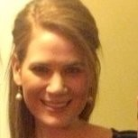
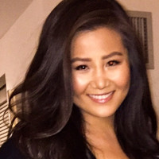
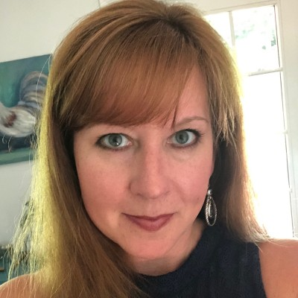
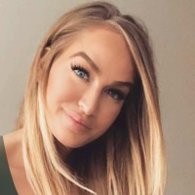


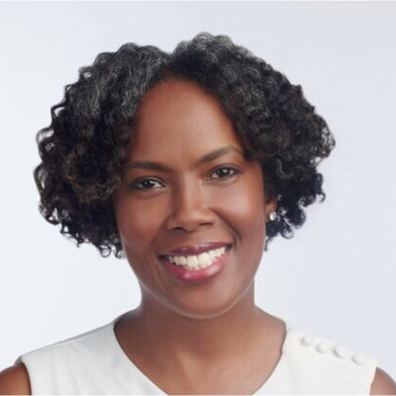
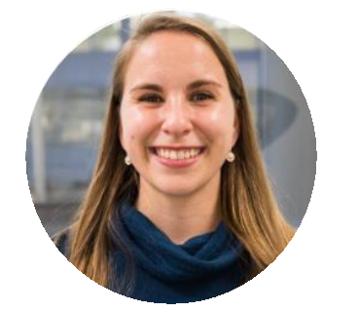
We’re happy to be here!
Diana Strandberg
Director, Client Services
Mimi Zhou
Account Manger
Jen Tabbal
Senior Content Director
Kelly McMahon
Art Director
Sterling Crain
Senior Designer
Bryan Finke
SVP, Strategy
Erica Huntley
Senior Strategist
Diana Prado
Strategy Analyst

Slide 3
Today’s Agenda
Our Process
Content Planning
Design Planning
Campaign Optimization

Slide 4
Our Process

Slide 5
Master Doc Organization
Central shared location
  https://docs.google.com/spreadsheets/d/16rdGva14K64zYlfehx6rV9dJLyzxdBo7gs_Vt6niOLM/edit?usp=sharing
    Please let us know which email address you'd like us to add to give you editing rights

Slide 6
Campaign Matrix
Live within shared doc
  Content
  Link URLs
Version control
  Edit in doc
  Highlight
  Send email alert – we'll unhighlight after we account for update

Slide 7
Campaign Updates
Layout / build complexity
  Defined during kick-off
Placeholder content
  With DR1 feedback

Slide 8
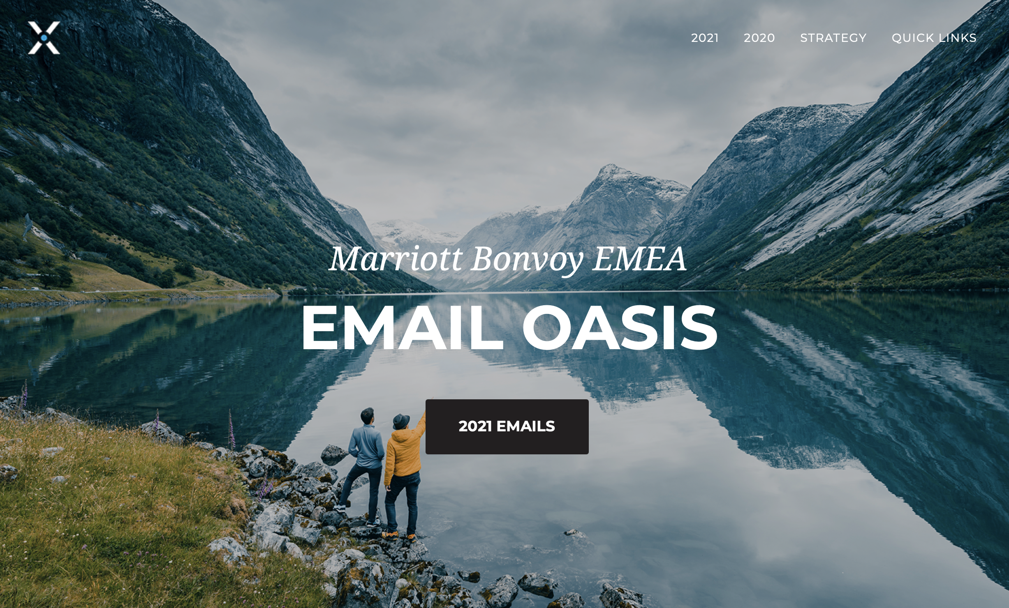
Oasis
http://preview.4at5.net/email_domains/mar/0001/mar_0001.html

Slide 9
Content Planning

Slide 10
Content Planning
Process
  Visibility to current content planning document
  Testing and optimization considerations
  Incorporating previous learnings
  Red flags
  Kick off
Discovery
  Quarterly content planning meetings
  Discuss realistic timeline - 2 months prior to next quarter? Is this feasible?
  EMEA and Data Axle content brainstorm
    Internal business partner commitments
    EMEA customer communication overview
    Upcoming offers and promos
    Other content opportunities
    Learnings from other MBV campaigns
    New Epsilon functionality

Slide 11
Design Planning

Slide 12



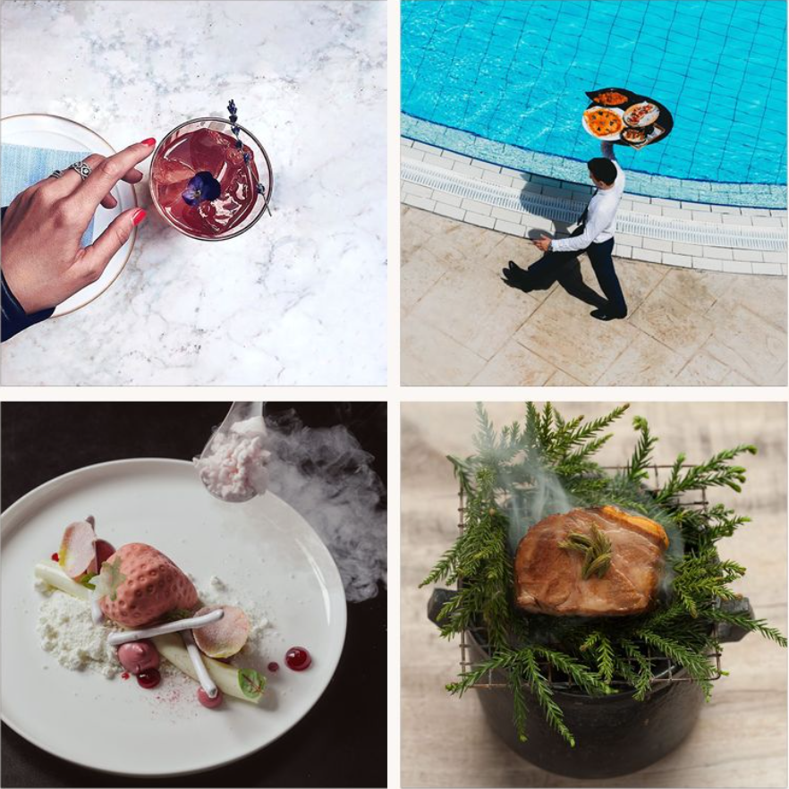
Design Planning
Properties
Destinations
Imagery
  Image guidelines
    New photography direction
      Singularly focused
      Compositionally clean
      Fewer, stronger colors (vibrant & bold)
      "Not all destinations are places" (Ex: F&B imagery, compelling & grand)
  Sourcing images
    Would you still like to own this or would you like us to source images?
    If we begin sourcing, are there any additional guidelines you have in the imagery you prefer?
  Create image library
    Could be great opportunity to partner together on image sourcing
    Each country could give us the images they'd prefer to use, will also help inform our efforts
    All images would be approved by your team before implementing in campaigns
Experiences
Food & Beverage

Slide 13
Design Planning
New Branded Template
  Style guide is currently being finalized
  Design work beginning
  Fluid rollout
  We are very excited!

Slide 14
Campaign Optimization

Slide 15
Components Of A Test & Learn Program
Learning Agenda
Learning Roadmap
Test Strategy
Results
& Review
Learning Log
Learning Library
Define on-going learning opportunities against key business initiatives
Rolling 6–12-month roadmap of prioritized learning opportunities
Defined testing strategy and approach to gain specific learning
Results and learnings of tests by campaign
Centralized log of all captured learnings and supporting test results
Extensive archive of learnings – accumulation of presentations
Campaign level

Slide 16
Approach To Learning Agenda
EXPLORE
Identify what we want to know & learn
CONFIRM
Make sure what we are seeking moves us forward
DEVELOP
Create the test and optimization plan
TRACK
Keep a record of test results and learnings
What have we wondered about?
What assumptions would we like to confirm?
Identify learning opportunities and approach
Prioritize based on impact, execution ability, and measurable
Refer to past learnings to develop new strategies as well as inform future learning initiatives
Will the acquired knowledge be useful in developing future strategy?
Does the acquired knowledge map to our marketing objectives?
Initial Test Audience: UK and UAE residents, with an English language preference

Slide 17
Sample: Learning Agenda
Category | Business Objectives | Key Questions | Test/Optimization Opportunity | Actions Taken
Email Performance | Establish benchmarks Increase email KPI’s through targeting and content optimization | Can we improve performance by leveraging additional customer data & insights? Are there technologies that will help improve engagement? | Develop an iterative subject line/pre-header testing approach each month to increase open rates Increase re-send email open rates by testing subject lines with greater urgency to non-clickers; also include non-openers
Versioning/ Personalization | Increase relevancy and engagement | Are we yielding the biggest impact/ROI from email versioning? If so, for which markets? Can we improve clicks by optimizing content with additional data assets? | Test showing current point balance to increase clicks and encourage redemptions
Content | Present content that drives valuable clicks | How do recipients engage with content? Do some articles drive more clicks than others? | Increase hero clicks by testing CTA copy alternatives to ‘Book Now’ CTA Increase hero clicks by testing CTA placement; consider higher placement in hero to capture first-click faster
New Member Enrollments | Grow Bonvoy member database | Is there a more comprehensive way of tracking and reporting on new member enrollments from email? What is the best way to convert? | Set-up enrollment code for all emails for more comprehensive tracking & improved reporting Test an enrollment message that includes benefits of membership & ease of sign-up to increase clicks & enrollments | Set-up enrollment code (Jan 2021)
Use learning agenda to build a 2021 roadmap of the prioritized learning opportunities
Agenda and roadmap will be reviewed & updated quarterly

Slide 18
Thank you!

